Slide 1
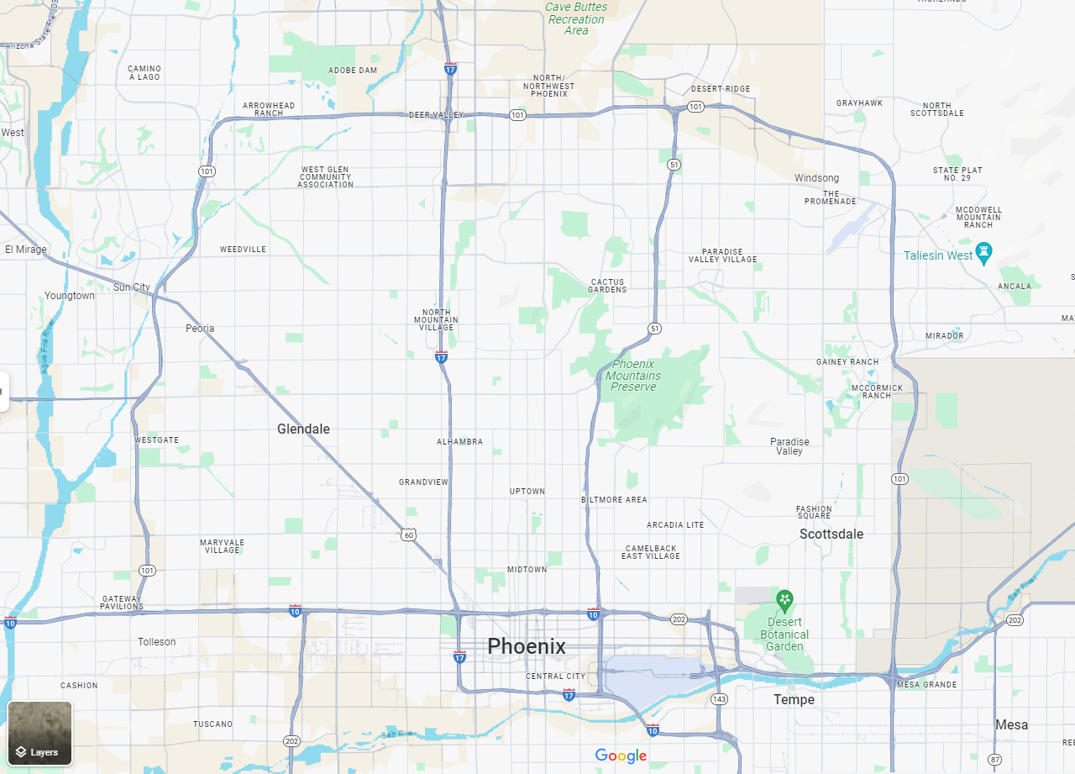
WHAT’S NEW IN REVIT 2024 / 2025
ORB University
ORB UNIVERSITY – June 19th, 2024 PRESENTED BY JHON HEREDIA
Notes:
Use this to guide you on what you will say. Don’t put text in the slides. Just read it from here.

Slide 2
Revit 2024
Revit 2025
Dark Theme / Dark mode.
My Insight
Topo Solid
Auto Sync w/ Twin motion
New display style
Documentation at sheets update:
Align Across Sheets
Place multiple views on sheet at once.
Search bar in project browser
Revision Schedule
New home screen
Sheet collection
Enhancement to project browser, search bar (highlight)
Topo solid from mass
Walls that automatically join or lock.
Shared views.
Swap views.

Slide 3
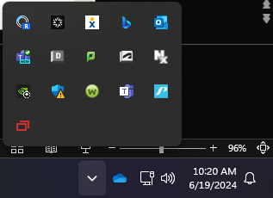
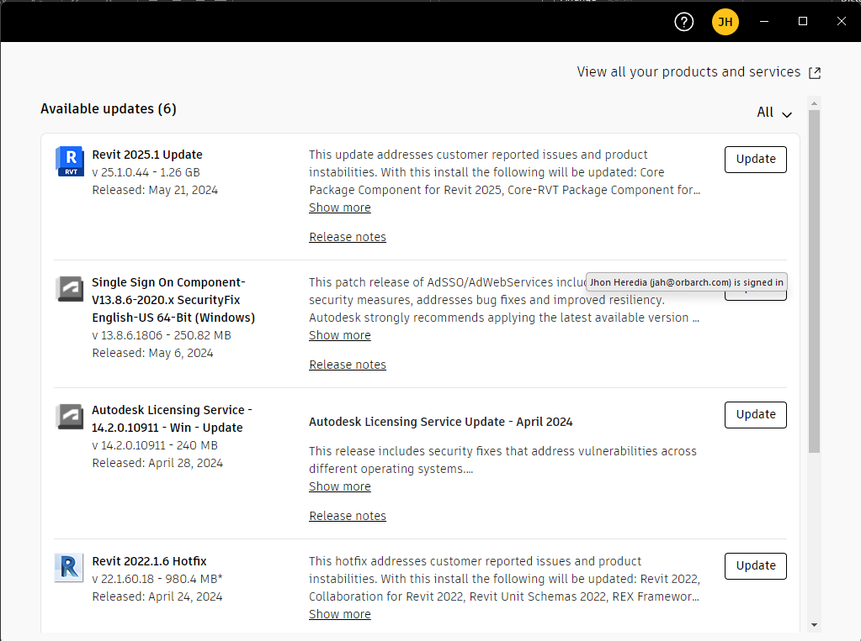
How to get Revit 2025
1st. Right Click on the Autodesk icon on your left bottom corner of the screen.
2nd Look for Revit 2025 in the available updates. If is not shown, go to “View all your products and services”

Slide 4
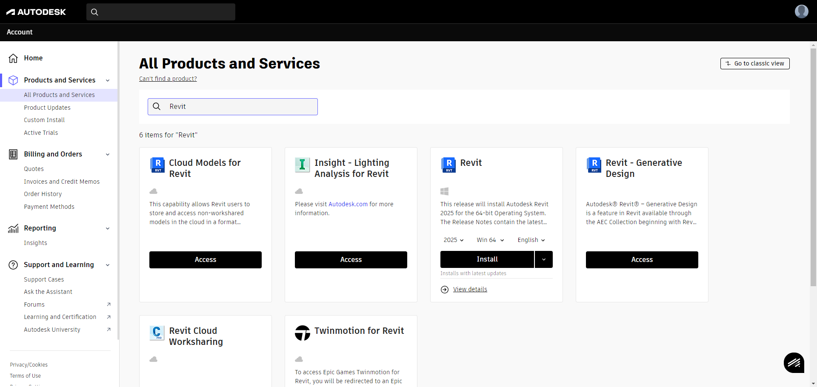
How to get Revit 2025
Type Revit on the search bar and then verify the version, operation system and language. Then, just click in install button.

Slide 5
The New Revit Home
Notes:
New Revit Home:
-How to view the project files
-Sort by:
-Date modified
-List view
Autodesk Projects:
Explain de options.

Slide 6
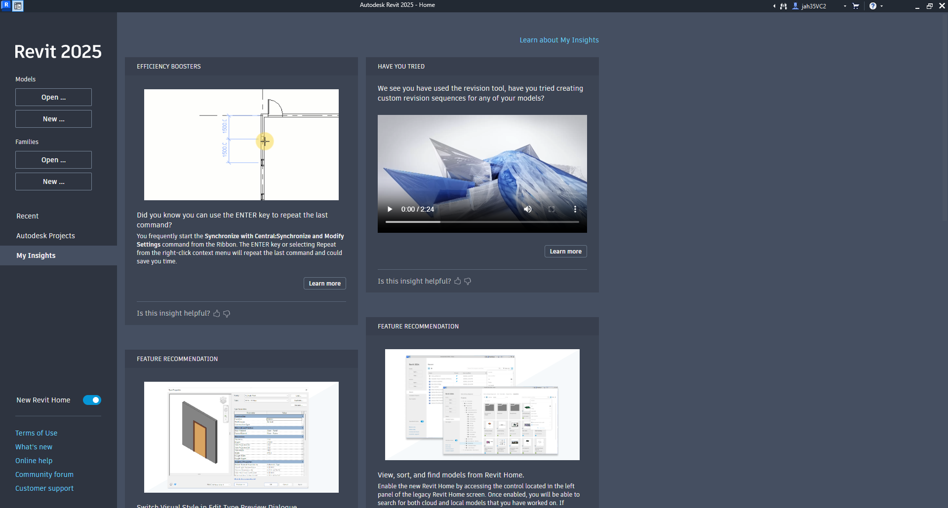
My Insight
My Insights is personalized information that is shown to you as individual insights and to your product administrator as team-based insights.
Notes:
s personalized information that is shown to you as individual insights and to your product administrator as team-based insights, both of which are based on your usage of an Autodesk product.

Slide 7
New Revit Home
Now the Revit home will have functions as the document explorer.

Slide 8
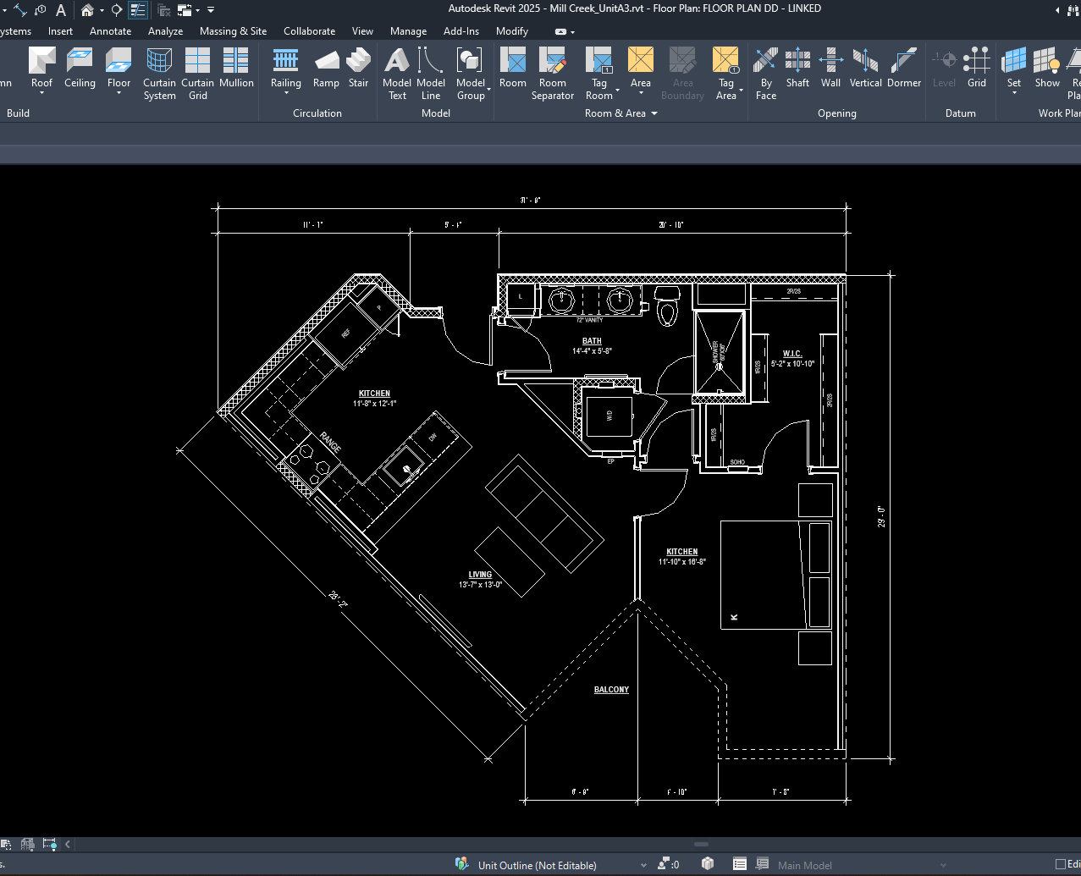
Dark vs Light mode
Notes:
There are a couple user interface setting that we can use for benefit of us.
This configuration is per user. So, no matter if you have the dark mode your file will be shown as your desktop configuration.

Slide 9
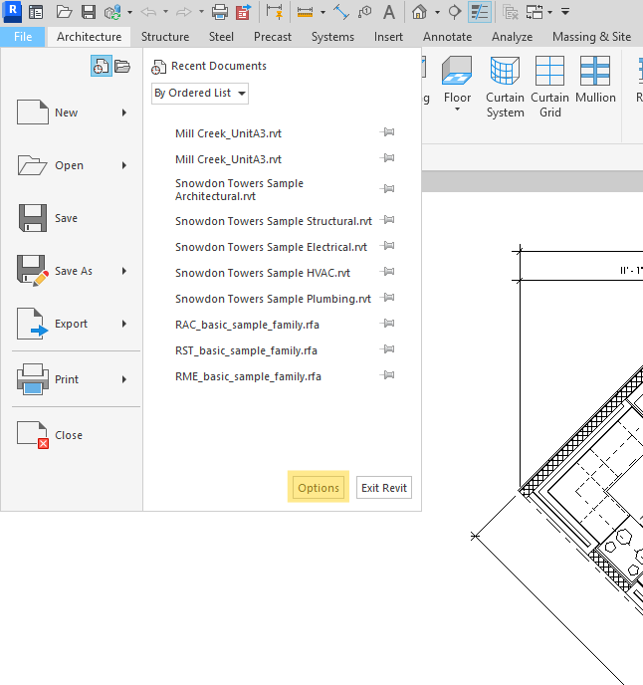
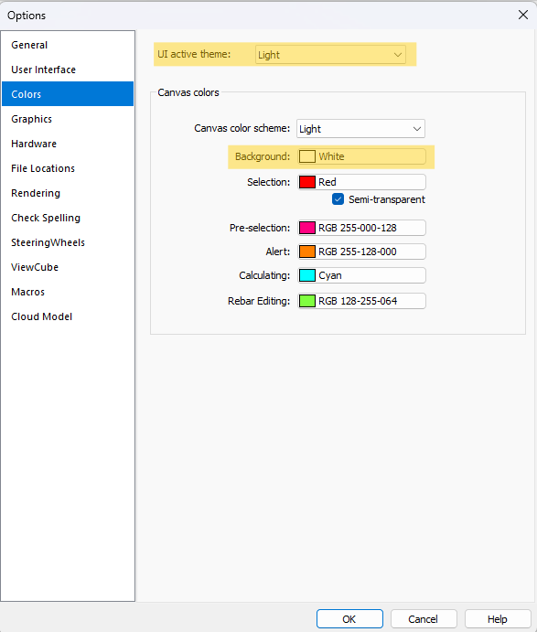
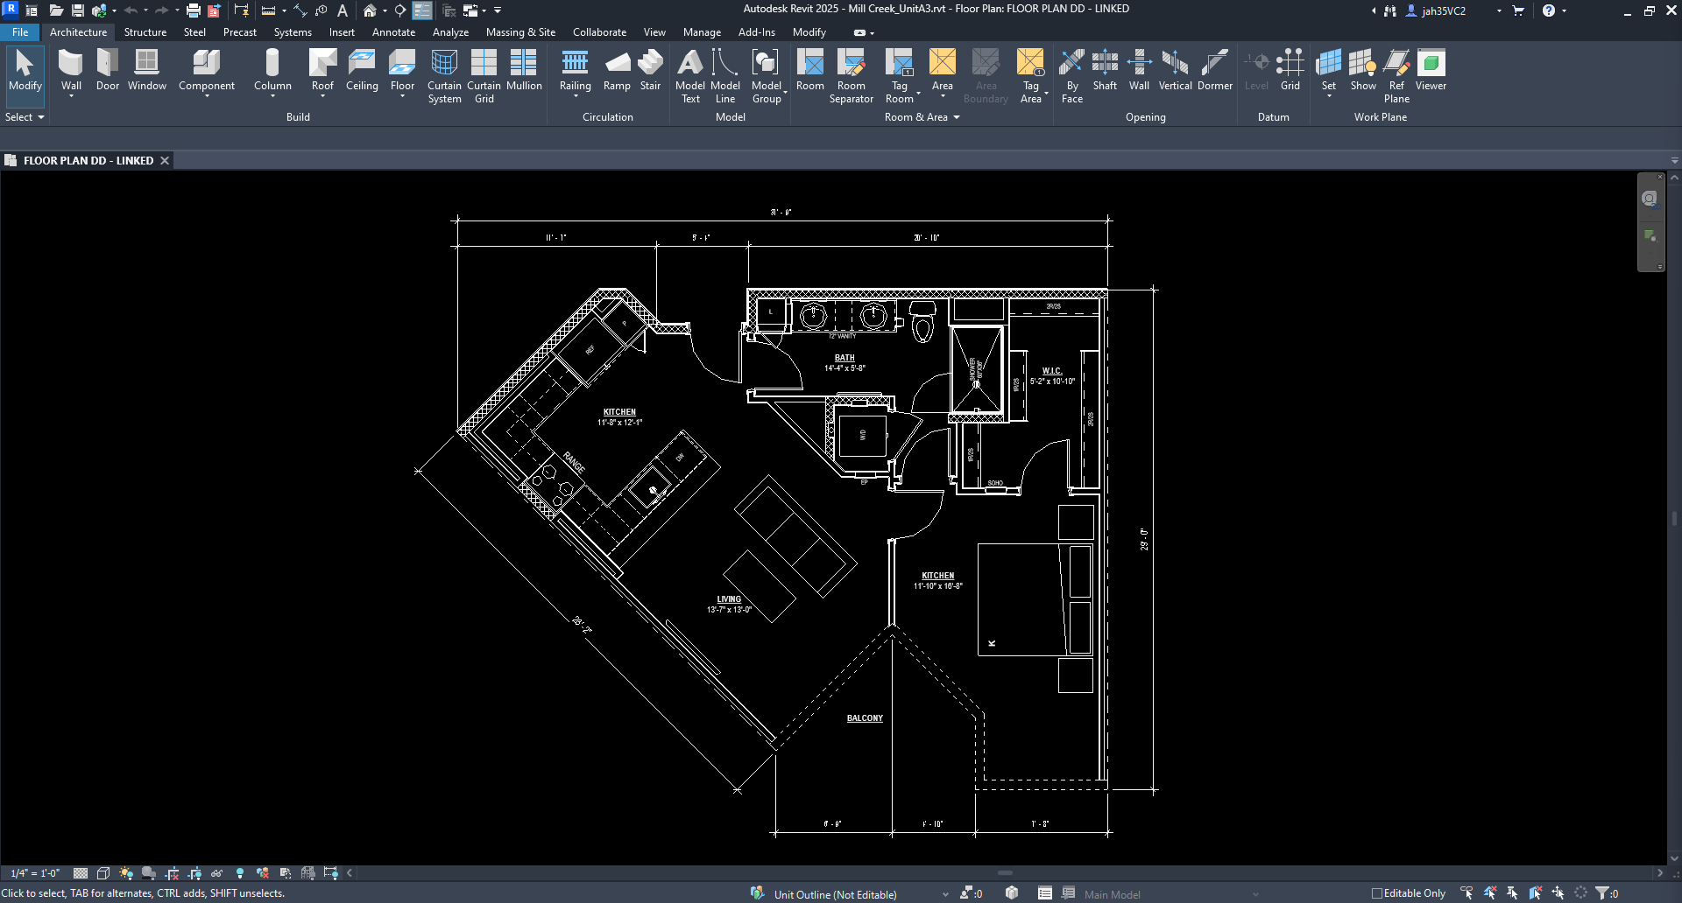
You can change the interface and the canvas to dark mode in Revit 2024 and 2025.
This is a user interface customization. Although, every time we create a snip or we share our screen the recommendation will be to use light canvas for an easy graphic understanding.

Slide 10
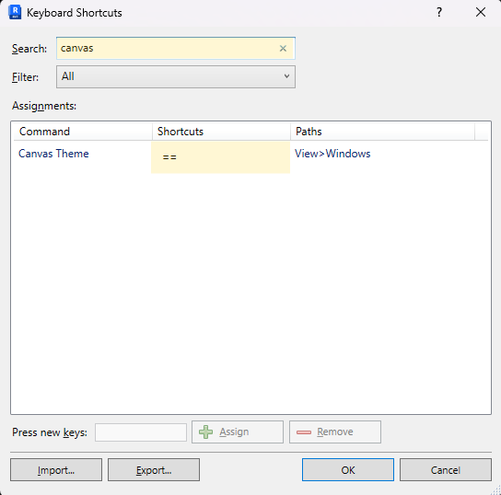
Short Cuts matters!
Type KS for Keyboard Shortcuts> Canvas> type your preferred shortcut easy to remember.

Slide 11
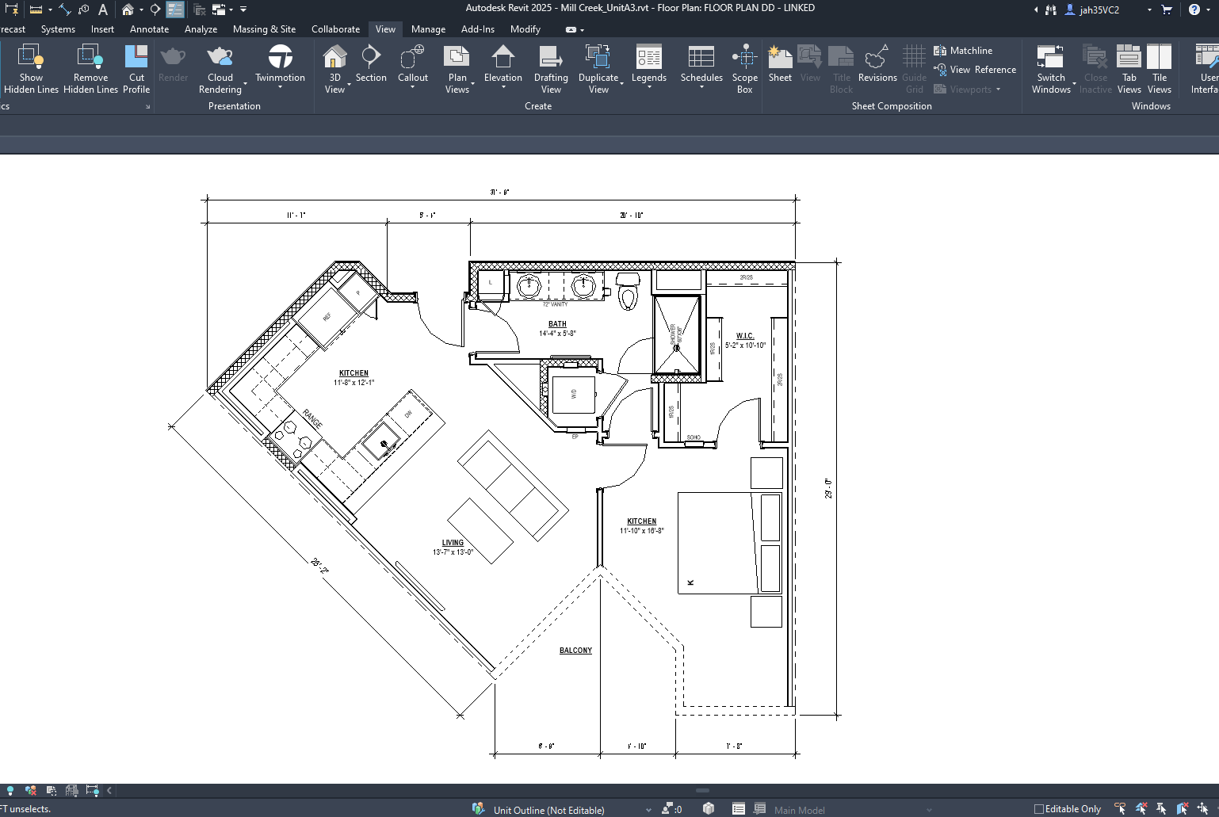
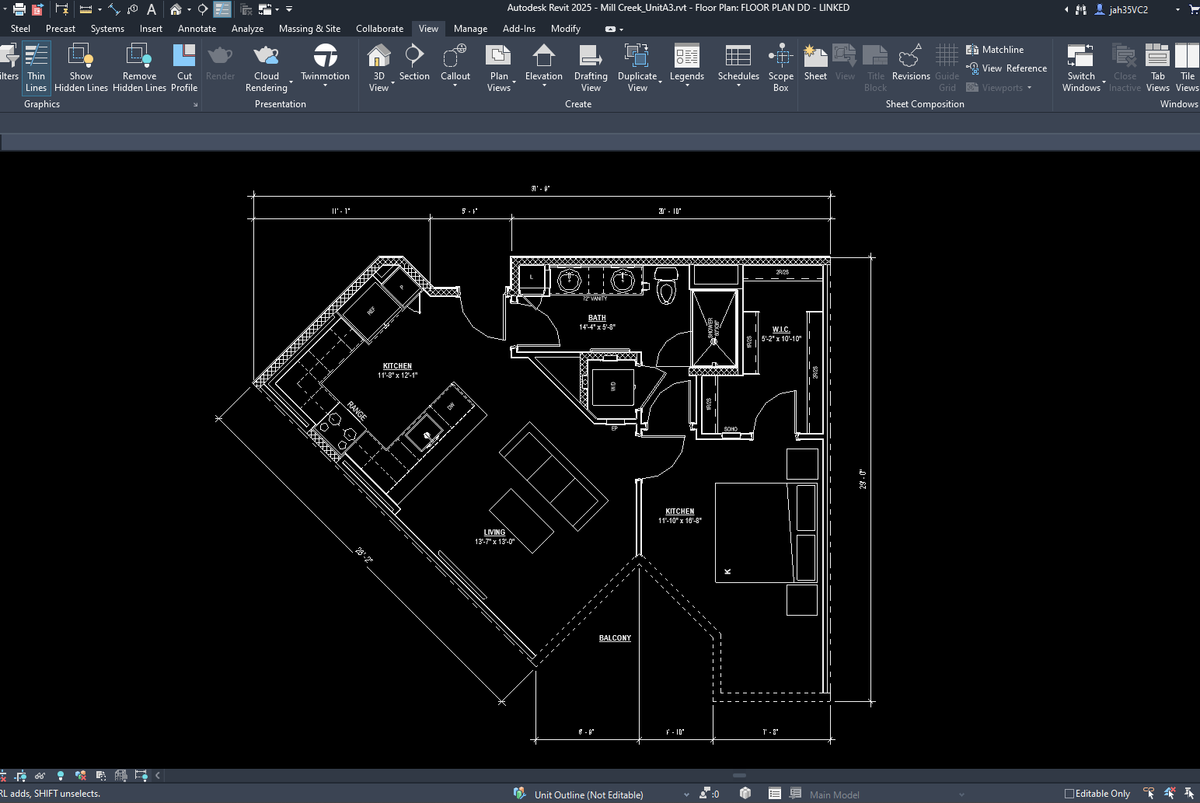
Dark UI but white canvas.

Slide 12
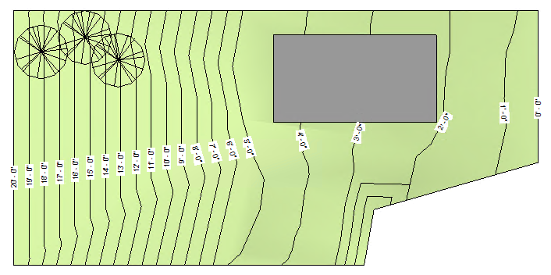
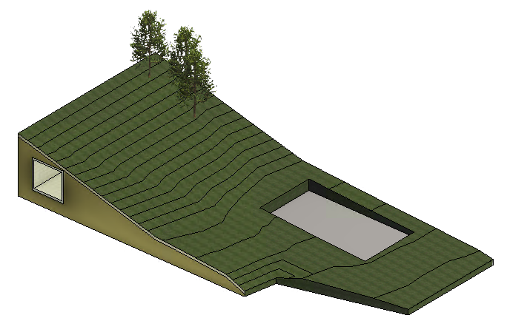
Toposolid
The Toposolid tool defines a topographical element using defined elevation points or imported data.
Toposolids are able to act as a host for the following elements:
Site components
Parking
Railings
Floor Based elements

Slide 13
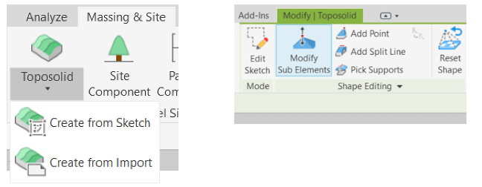
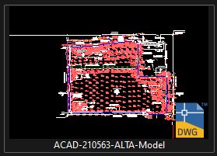
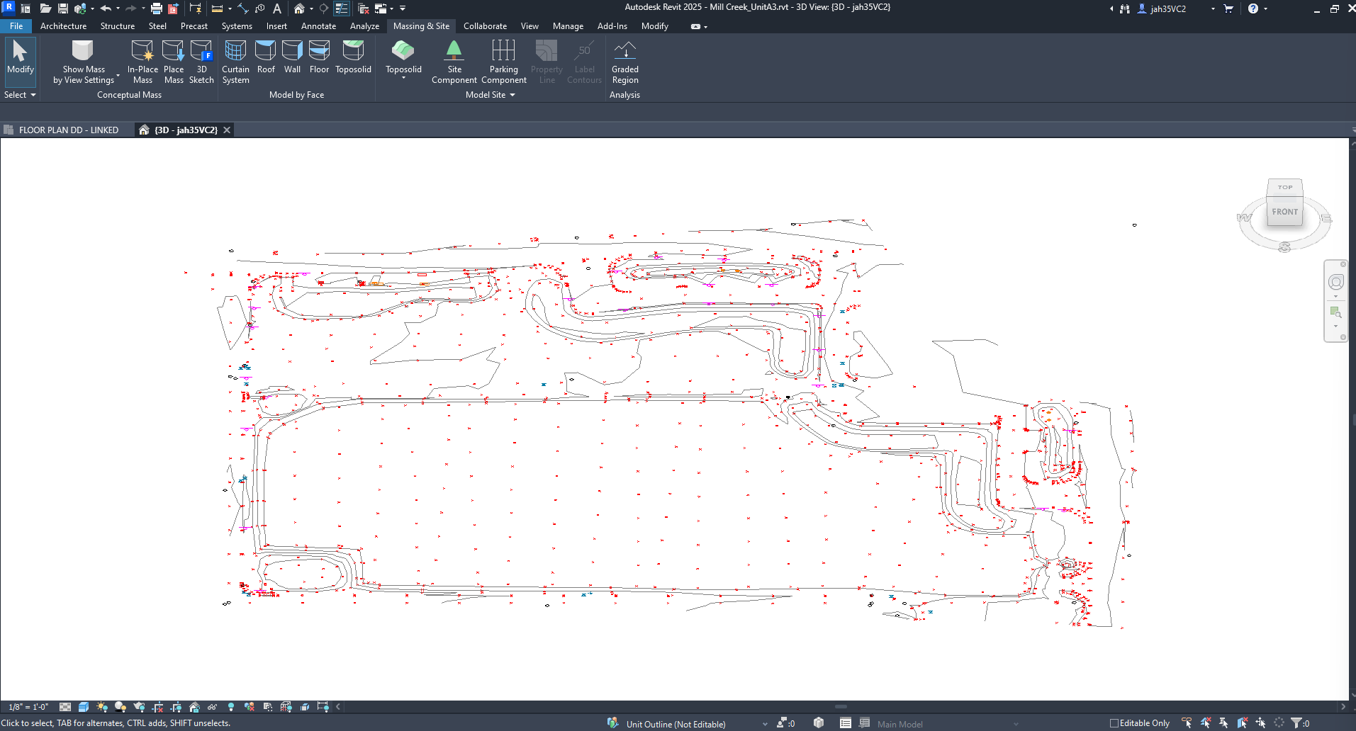
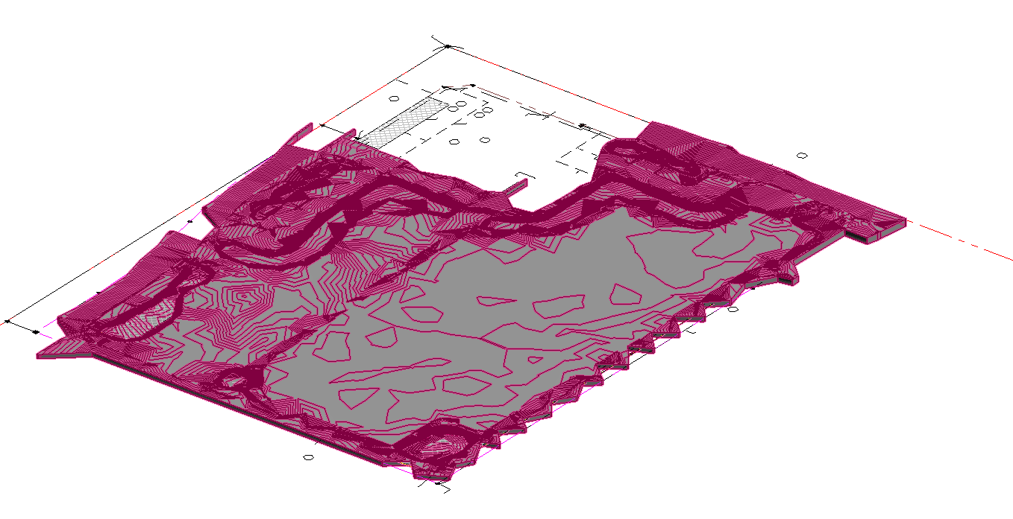
How to create a Toposolid?
You can model from sketch as simple as modeling a floor family.
Additionally, you can model from Topo file.

Slide 14
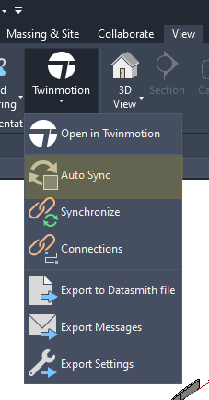
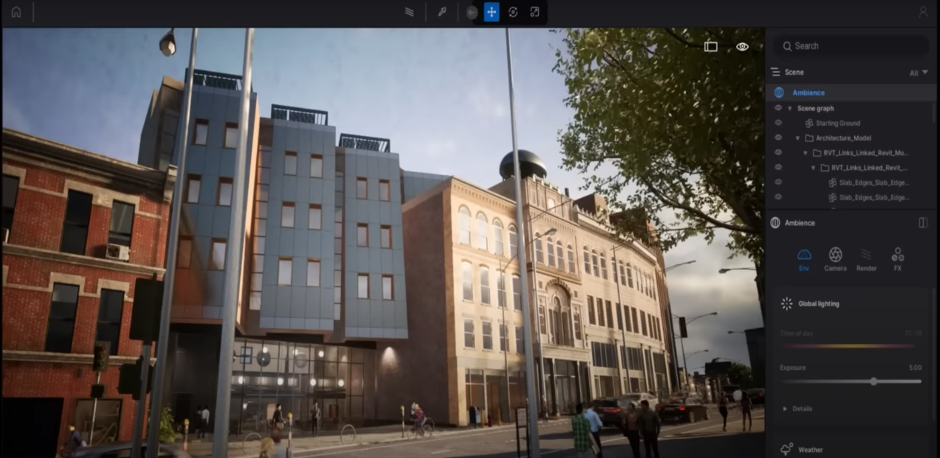
Auto Sync w/ Twin motion

Slide 15
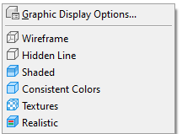
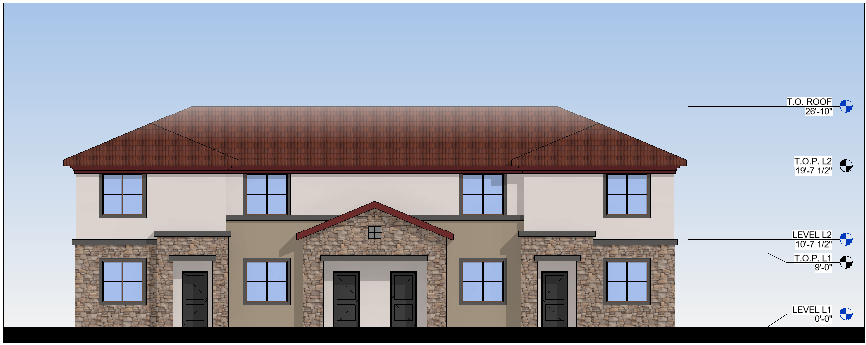
Consistent colors vs Texture view style.
Consistent colors style.
Texture view style.

Slide 16
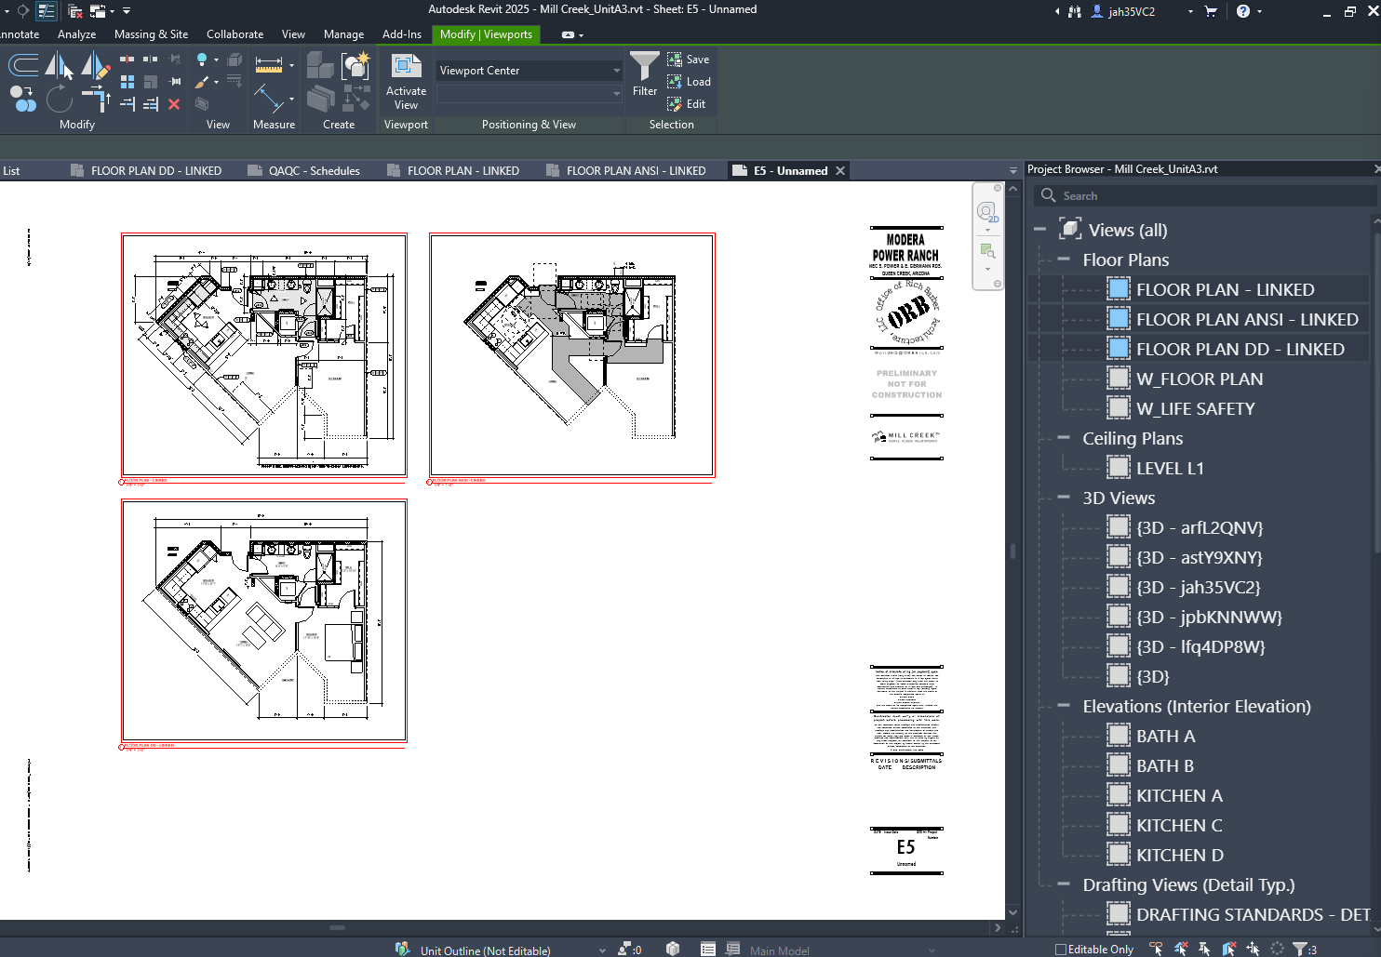
Documentation at sheets update:
Place multiple views on sheet at once:
Select multiple views in the project browser then drag and inside a sheet, automatically will align the views.
Tip: Control + Scroll = Zoom in and zoom out in Project Browser.

Slide 17
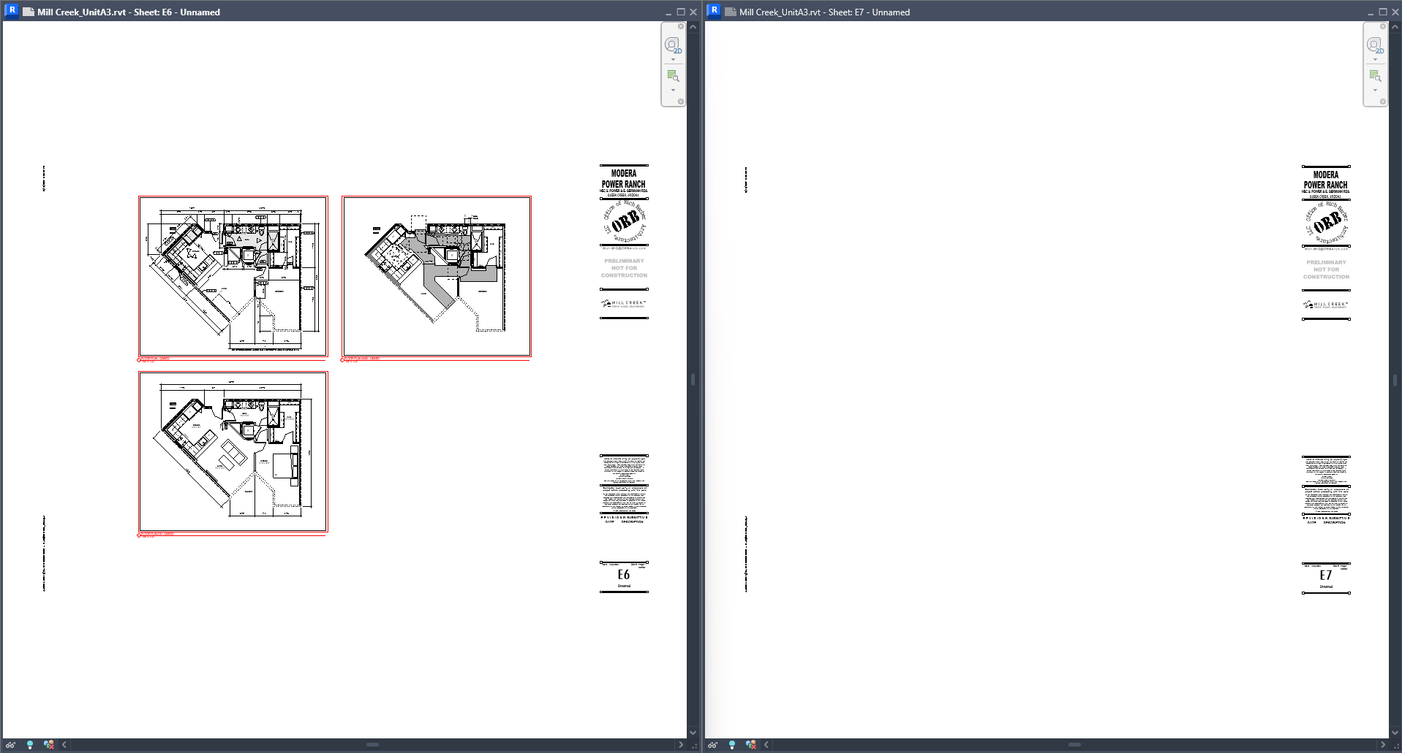
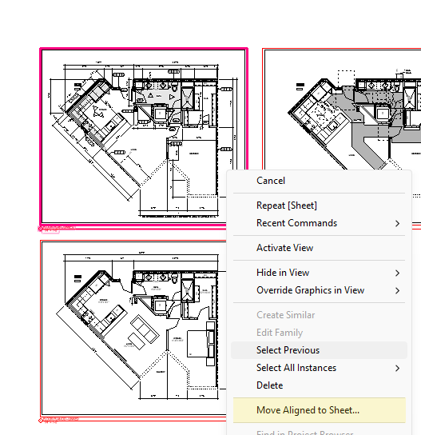
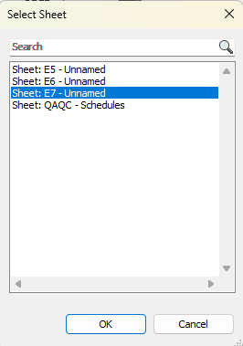
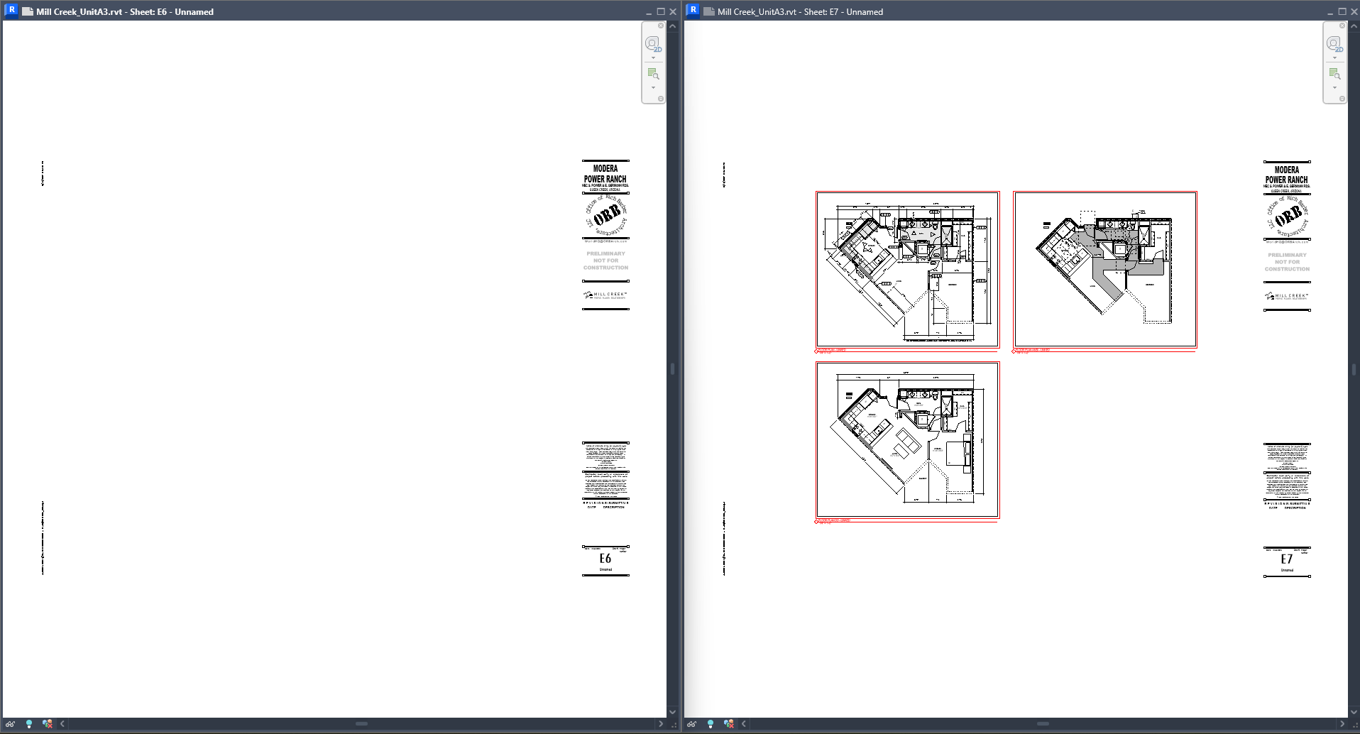
Documentation at sheets update:
Place multiple views on sheet at once. You can now move views between sheets aligned in the same place.
1
2
3
4

Slide 18
Sheet collection and project browser.
With the Sheet Collections feature, you can assign any sheet in the model into flexible groupings. Additionally, you can organize sheets per Sheet Sets.
Sheet browser
Now, we can group sheets in Sheet Sets and these Sheet Sets inside Sheet Collections.
Sheet Collection
Sheet Set
Sheet

Slide 19
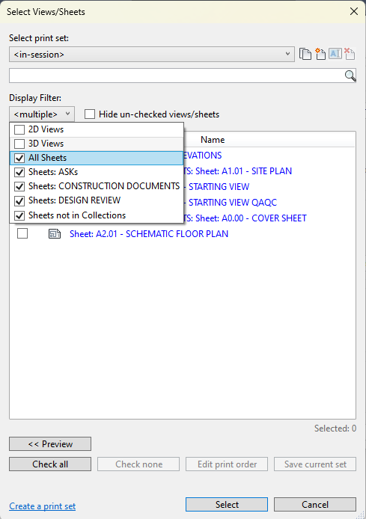
Sheet collection and project browser.
Right click on the sheet browser then new collection.
We can print by Sheet Collection.

Slide 20
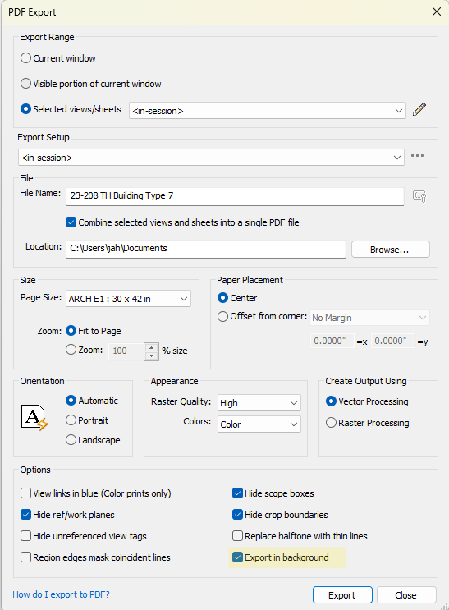
Talking about printing.
Now we can print and keep working in our models.

Slide 21
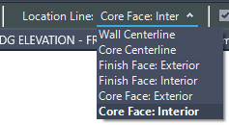
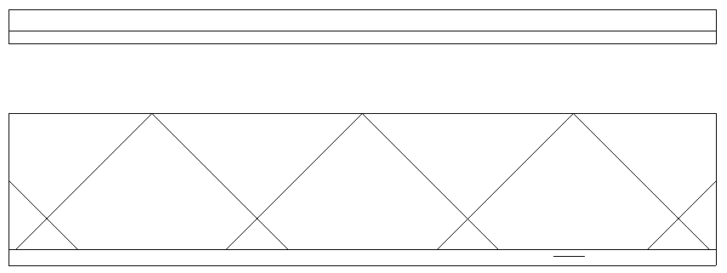
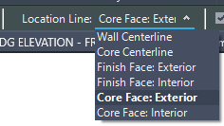
Create Walls with Auto Join and Lock
You can automatically join a newly created architectural wall with the adjacent wall or join and lock them together to speed up your modeling process when working with multiple walls.
Now, we don’t need to join walls manually with join geometry.

Slide 22
Create Walls with Auto Join and Lock
What not to do.
Overlapping line location. If we model a wall overlapping another wall as always Revit will give us a warning.
Never let gap between walls or you will have bad function of the tool

Slide 23
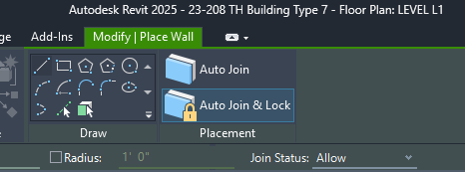
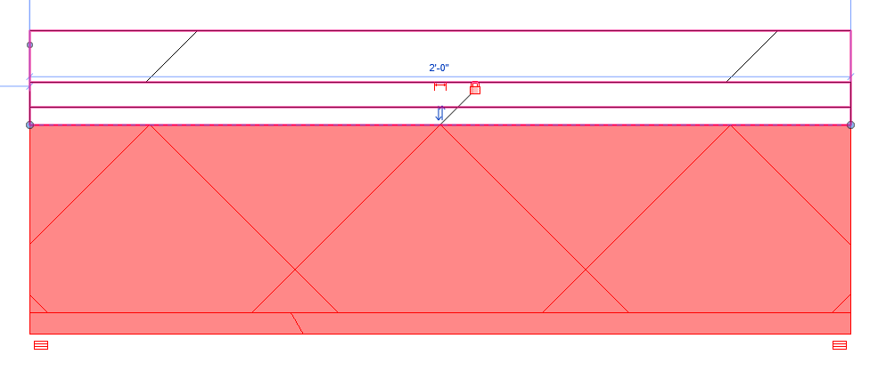
Create Walls with Auto Join and Lock
How make it work.

Slide 24
Create Walls with Auto Join and Lock
Windows and doors will create the opening in the second wall.
Is just a matter of place them on the right wall.

Slide 25
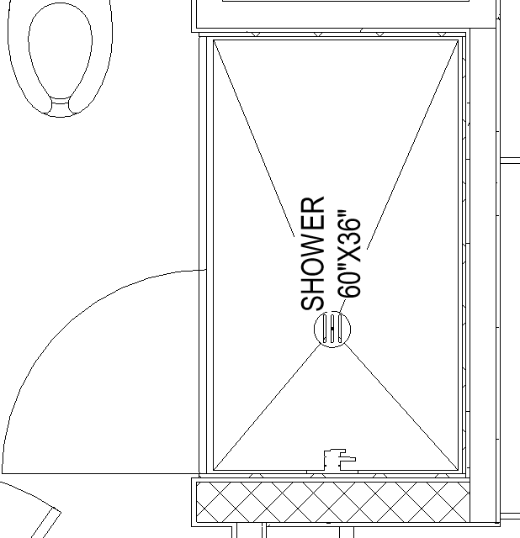
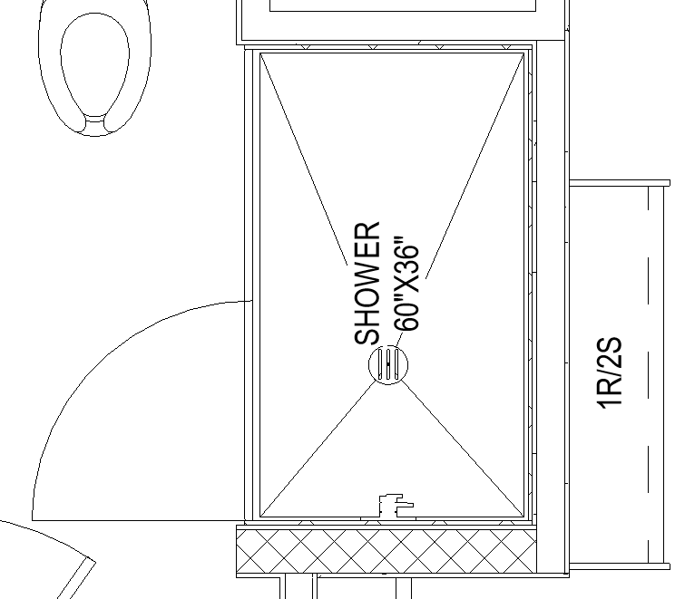
Talking about walls.
In Canvas Wall Wrapping Control.
Control wall end wrapping conditions with controls in plan views.

Slide 26
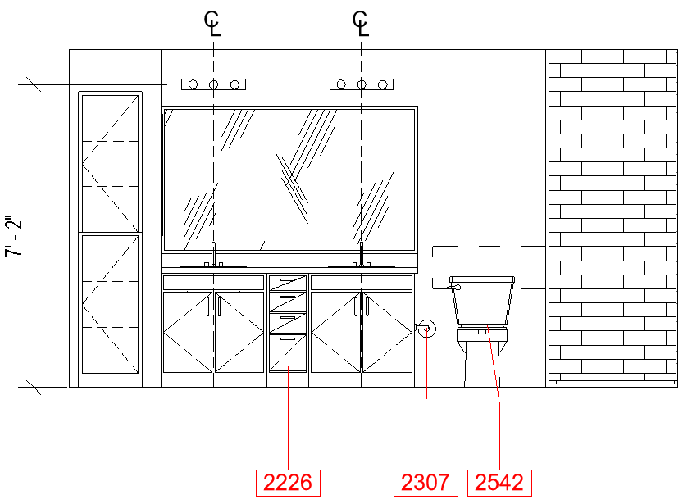
Multiple Alignment
You can now align and distribute multiple keynotes, text notes, and tags.

Slide 27
Thank you,

